Slide 1
Web Application Development With Java CEJV 559
The Servlet

Slide 2
The Servlet
import java.io.IOException;
import java.io.PrintWriter;
import javax.servlet.ServletException;
import javax.servlet.annotation.WebServlet;
import javax.servlet.http.HttpServlet;
import javax.servlet.http.HttpServletRequest;
import javax.servlet.http.HttpServletResponse;
@WebServlet(name=“SampleTestServlet", urlPatterns={"/test"})
public class TestServlet extends HttpServlet {

Slide 3
The Servlet
@Override
protected void doPost(HttpServletRequest request,
HttpServletResponse response)
throws ServletException, IOException {
response.setContentType("text/html");
try (PrintWriter out = response.getWriter()) {
out.println("<h1>HTML from servlet</h1>");
}
}

Slide 4
The Servlet
@Override
protected void doGet(HttpServletRequest request,
HttpServletResponse response)
throws ServletException, IOException {
doPost(request, response);
}
}

Slide 5
Servlet Concepts
The doGet method processes all HTTP requests that use the GET method
The doPost method processes all HTTP requests that use the POST method.
Both methods accept as parameters
the HttpServletRequest object
the HttpServletResponse object

Slide 6
@WebServlet
@WebServlet(name="SampleTestServlet",
urlPatterns={"/test"})
Annotation that defines the class as a servlet
Container searches for classes with this annotation and loads them into the JVM
name attribute is the name by which the servlet is referred to in other configuration instances (optional)

Slide 7
@WebServlet
@WebServlet(name="SampleTestServlet",
urlPatterns={"/test"})
urlPatterns is the URL name of a servlet that is appended to the web site URL (optional)
Servlets may have more than one url
@WebServlet(name="SampleTestServlet",
urlPatterns={"/test", "/sample"})

Slide 8
@WebServlet
If there will be only one urlPattern then the annotation value syntax can be used
@WebServlet("/test")
Servlet may have either a value or a urlPattern but not both
If neither are present then the servlet name is the urlPattern

Slide 9
How to code a servlet
Servlets extend the HttpServlet class
doGet method overrides the doGet method of the HttpServlet class & processes all GET HTTP requests
accepts the HttpServletRequest object
doPost method overrides the doPost method of the HttpServlet class & processes all POST HTTP requests
accepts the HttpServletResponse object

Slide 10
How to code a servlet
setContentType:
method of the response object
sets the content type of what is returned to the browser
getWriter:
method of the response object
returns a PrintWriter object used to send HTML to the browser
Content type must be set before creating a PrintWriter object
Allows the getWriter method to return a PrintWriter object that uses the proper content type

Slide 11
Requests
A Form tag that requests the servlet
<form action="addToEmailList" method="post">
The URL displayed in the browser
http://localhost:8080/ch06email/addToEmailList
Another Form tag that requests the servlet
<form action="email/addToList" method="post">
The URL displayed in the browser
http://localhost:8080/ch06email/email/addToList

Slide 12
Requests
An A tag that requests a servlet
<a href="addToEmailList?firstName=John&lastName=Smith">
Display Email Entry Test
</a>
A URL that requests a servlet
http://localhost:8080/ch06email/addToEmailList?
firstName=John

Slide 13
GET
Use the GET method when…
Request reads data from the server.
Request can be executed multiple times without causing problems.

Slide 14
POST
Use the POST method when…
Request writes data to the server.
Executing request multiple times may cause problems.
Parameters in the URL should not appear for security reasons.
Parameters should not be included in a bookmark
Transferring more than 4 KB of data.

Slide 15
Five common methods of a servlet
public void init() throws ServletException{}
public void service(HttpServletRequest request,
HttpServletResponse response)
throws IOException, ServletException{}
public void doGet(HttpServletRequest request,
HttpServletResponse response)
throws IOException, ServletException{}
public void doPost(HttpServletRequest request,
HttpServletResponse response)
throws IOException, ServletException{}
public void destroy(){}

Slide 16
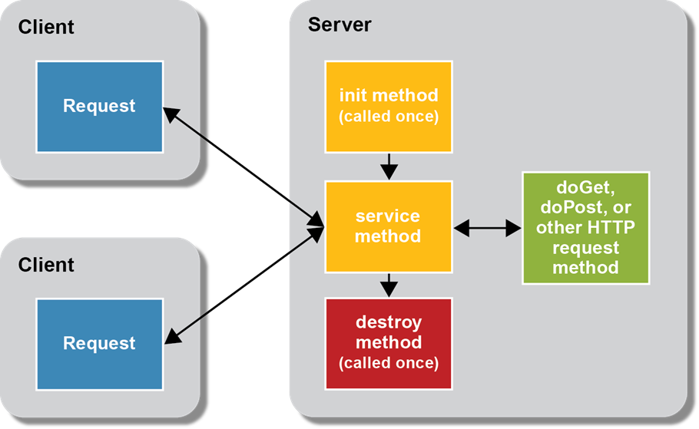
The life cycle of a servlet

Slide 17
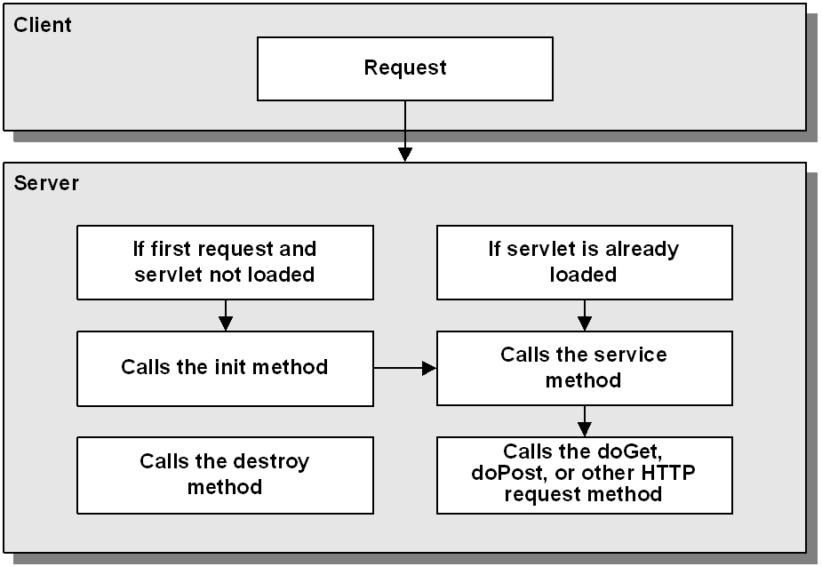
How the server handles a request for a servlet

Slide 18
HttpServletRequest methods
getParameter(String param)
Returns the value of the specified parameter as a string if it exists or null if it doesn’t
Defined in the value attribute of the control in the HTML or JSP file.
getParameterValues(String param)
Returns an array of String objects containing all values that the given request parameter has or null if the parameter doesn’t have any values

Slide 19
HttpServletRequest methods
Servlet code that gets text from a text box
String firstName = request.getParameter("firstName");
Servlet code that determines if a box is checked
// returns the value or "on" if checked, null otherwise.
String rockCheckBox = request.getParameter("rock");
if (rockCheckBox != null)
{
// rock music was checked
}

Slide 20
HttpServletRequest methods
Servlet code that reads and processes multiple values from a list box
//returns the values of the items selected in a list box
String[] selectedCountries =
request.getParameterValues("country");
for (String country : selectedCountries)
{
// code that processes each country
}

Slide 21
The ServletContext object
Because servlets inherit the GenericServlet class, the getServletContext method is available to all servlets
Use the ServletContext object to:
read global initialization parameters
work with global variables
write data to log files

Slide 22
Code that gets the absolute path for a file
// getServletContext comes from GenericServlet
ServletContext sc = this.getServletContext();
// getRealPath comes from ServletContext
String path =
sc.getRealPath("/WEB-INF/EmailList.txt");
A more concise way to write the same code
String path = this.getServletContext()
.getRealPath("/WEB-INF/EmailList.txt");

Slide 23
Important Rule
THERE MUST NOT BE ANY SPACES IN THE PATH TO A FILE

Slide 24
Storing data in the request object
How to set a request attribute
User user = new User(firstName, lastName, email);
request.setAttribute("user", user);
How to get a request attribute
User user = (User) request.getAttribute("user");

Slide 25
Storing data in the request object
How to set a request attribute for a primitive type
int id = 1;
request.setAttribute("id", new Integer(id));
How to get a request attribute for a primitive type
int id = (Integer) request.getAttribute("id");

Slide 26
Forwarding to a Servlet or JSP
Forwarding is an action that occurs on the server
HttpServlet object transfers control to another HttpServlet object such as a Servlet or JSP
Original request and response objects are passed to the object you are forwarding to
Attributes stored in the request are available to the object
Output of the object is sent to the client’s browser

Slide 27
Forwarding to a Servlet or JSP
How to forward the request
String url = "/index.html";
getServletContext().getRequestDispatcher(url)
.forward(request, response);
URL can be an html, Servlet, JSP, JSF or any other valid type hosted on a server

Slide 28
Forwarding to a Servlet or JSP
How to forward the request to a servlet
String url = "/cart/displayInvoice";
getServletContext().getRequestDispatcher(url)
.forward(request, response);
Servlets usually do not have an extension

Slide 29
Redirecting
Sends a temporary redirect response to the client using the specified redirect location URL
Redirect location URL is entered into the browser’s address bar and you are sent to that page
Original request and response are lost

Slide 30
How to redirect a response…
…relative to the current directory
response.sendRedirect("email");
…relative to the servlet engine
response.sendRedirect("/musicStore/email/");
…to a different web server
response.sendRedirect("http://www.moose.com/email/");

Slide 31
web.xml
Before annotations were widely used all web application configuration occurred in a web.xml file
File is in the WEB-INF folder
A protected folder that is not accessible to a client’s browser

Slide 32
XML elements for working with servlet mapping

Slide 33
XML elements for initialization parameters

Slide 34
Code that gets an initialization parameter that’s…
…available to all servlets
String custServEmail = this.getServletContext()
.getInitParameter("custServEmail");
…available to the current servlet only
String relativePath = this.getServletConfig()
.getInitParameter("relativePathToFile");

Slide 35
XML elements for working with error handling

Slide 36
How to provide error-handling for an HTTP 404 status code
XML tags
<error-page>
<error-code>404</error-code>
<location>/error_404.html</location>
</error-page>
error_404.html file
<h1>404 Error</h1>
<p>The server was not able to find the file you requested.</p>
<p>To continue, click the Back button.</p>

Slide 37
How to provide error-handling for all Java exceptions
XML tags
<error-page>
<exception-type>java.lang.Throwable</exception-type>
<location>/error_java.jsp</location>
</error-page>
error_java.jsp file
<h1>Java Error</h1>
<p>Sorry, Java has thrown an exception.</p>
<p>To continue, click the Back button.</p>
<h2>Details</h2>
<p>Type: ${pageContext.exception["class"]}</p>
<p>Message: ${pageContext.exception.message}</p>

